Slide 1


SmartTransit : A Data Driven System for Navigating and Analyzing Public Transport
Explore the pulse of Boston's subway system. This presentation dives into data-driven insights and interactive visualizations of the Red, Green, Orange, and Blue lines.
Presented By: Priyanka Maan and Mitul Nakrani

Slide 2
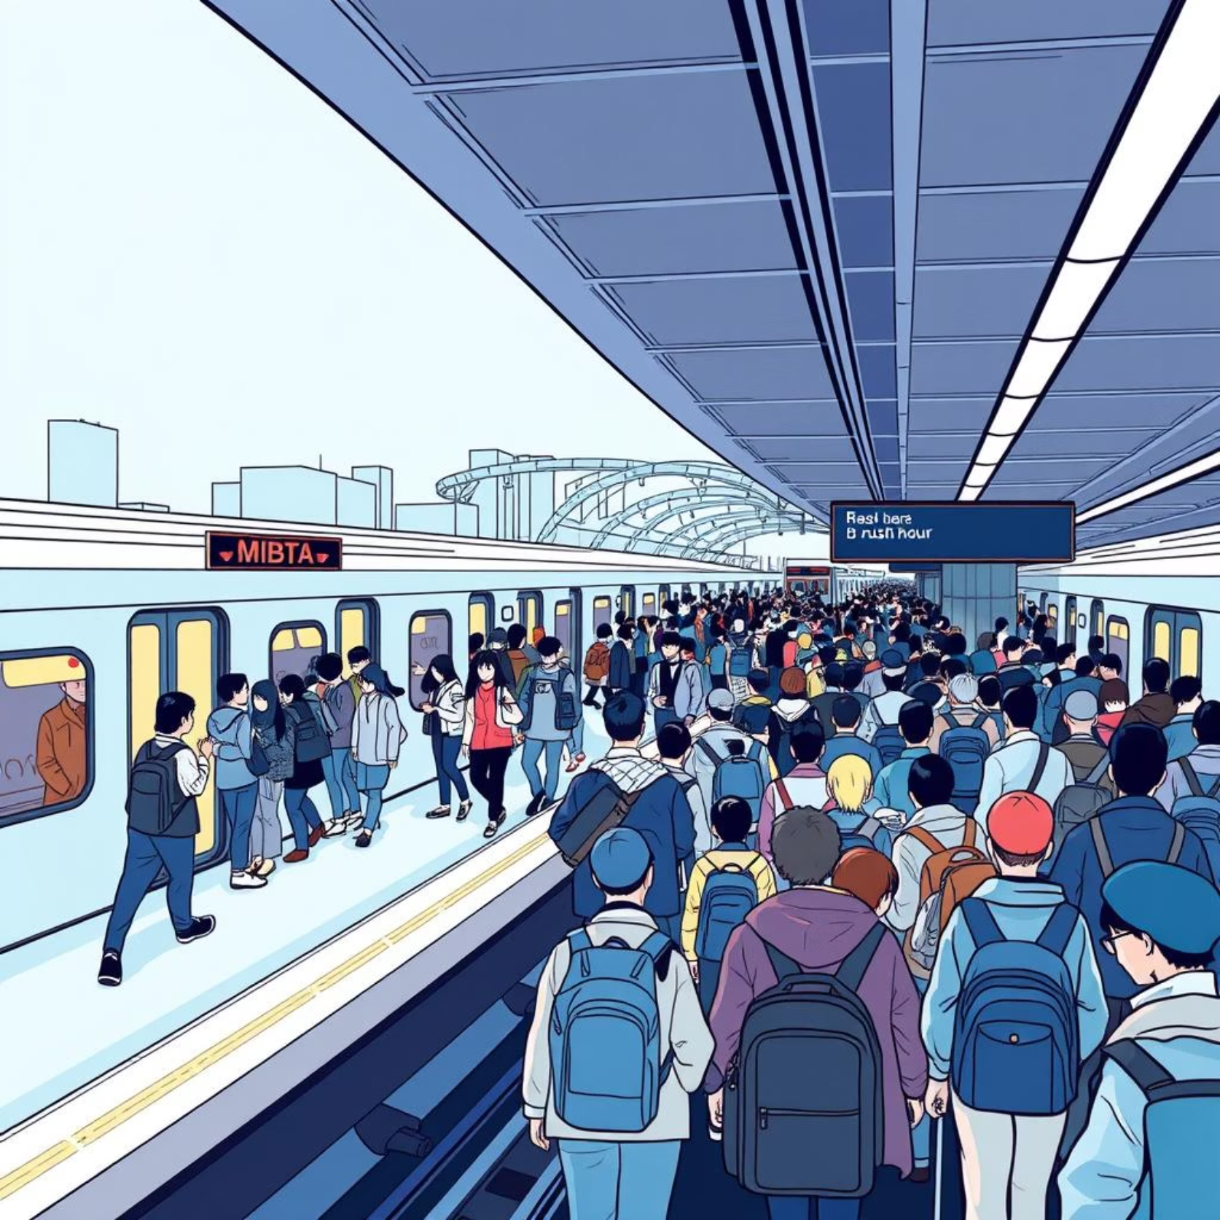
MOTIVATION
The MBTA network sees an average of 425,000 weekday station entries, with approximately 200,000 on weekends.
Decision Making: City planners need quick insights for infrastructure decisions
Public Benefit: Commuters want to understand their transit network better.
Technical Challenge: Bridging the gap between raw data and actionable insights.
Environmental Impact: Optimizing public transit reduces carbon footprint and traffic congestion.
Rider Fare Savings: Better transit planning saves a lot in costs annually for the end user.
Accessibility for All: Stations analysis helps people with disability to transit safely.

Slide 3
DATA INSIGHTS & PROCESSING
MBTA GTFS Official Feed: Data fetched from Massachusetts Bay Transportation Authority Link.
Additional Dataset: Transit Times Dataset is fetched from MassDoT open dataset directory Link.
Format: General Transit Feed Specification (GTFS) - Industry standard
Processing: Converted GTFS data to CSV for analysis
Fetch GTFS data from MBTA official feed and other sources.
Extract relevant files (stops.txt, travel_times.csv, routes.txt, facilities.txt, connections.csv, etc.)
Transform and Clean unstructured data into CSV format (stations, connections, locations, station_amenities)
Calculate network metrics and other analytics as required.
Create in-memory SQLite database for queries.

Slide 4

PROJECT SCOPE
AI Assistant
Route Selection with Travel Time Calculation
Ask questions in plain English and get SQL-powered answers instantly
Find routes and travel time by line, travel time, or specific station names
Analytics Dashboard
Accessibility Insights
Deep dive into network efficiency, centrality, and performance stats
Identify stations with elevators, ramps, and wheelchair access

Slide 5
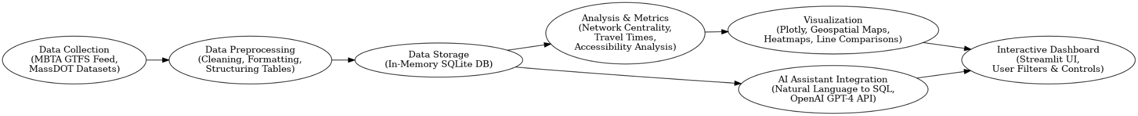
METHODOLOGY & TECHNOLOGY USED
Data Collection: CSV files
Data Processing: Pandas, Numpy, NetworkX for graph analysis. SQLite In memory for querying.
Visualization Layer: Plotly for interactive charts
AI Integration: OpenAI GPT-4 for natural language processing
User Interface: Streamlit for web deployment
Frontend: Streamlit, Plotly, HTML/CSS
Backend: Python, Pandas, NetworkX
Database: SQLite (in-memory)
AI/ML: OpenAI GPT-4 API
Analytics: NumPy, SciPy for calculations

Slide 6

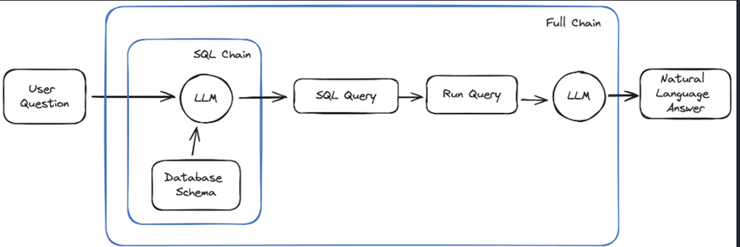
AI ASSISTANT
GPT - 4 powered AI Assistant
Natural Language Queries to Insightful results & visualizations
SQLite database

Slide 7

VISUALIZATIONS
Network Graphs & Centrality Heatmaps: Identify hubs, connectivity patterns, and bottlenecks
Multi-panel Line Comparisons: Compare efficiency, stations, connections across lines
Travel Time Analysis: Optimize schedules and identify slow connections
Geographic Scatter Plots: Analyze spatial distribution and accessibility
Network Visualizations: Immersive exploration of network density and patterns

Slide 8

DEMO

Slide 9
LIMITATIONS
Static and Mode-Limited Data: The platform relies on scheduled GTFS feeds and static datasets, focusing only on MBTA’s subway network without multi-modal integration.
Data Quality and Completeness: Accessibility and facility information may be outdated or incomplete due to reliance on public datasets.
Technical Constraints: In-memory storage limits scalability for large datasets, and the AI query interface may misinterpret complex or ambiguous queries.

Slide 10
CONCLUSION AND FUTURE WORK
Conclusion
Built comprehensive analytics platform for Boston subway network
Integrated AI to make data analysis accessible to everyone
Created interactive visualizations for deeper insights
Demonstrated potential for smarter transit planning
Future Efforts
Real-time GTFS Integration: Live transit data feeds
Predictive Analytics: ML models for delay prediction
Multi-modal Analysis: Include bus and commuter rail
Historical Analysis: Track network changes over time
API Development: RESTful API for third-party developers

Slide 11
THANK YOU!!
GITHUB REPOSITORY LINK - https://github.com/MitulNakrani003/DS5110IDMP-Project

